Slide 1
Logarithms and exponentials are reciprocal functions
INSERT
VIDEO
HERE

Slide 2

Logarithms and exponentials are reciprocal functions
$$\log_{b}\left(b^{y}\right)≡y$$
INSERT
VIDEO
HERE

Slide 3

Logarithms and exponentials are reciprocal functions
$$\log_{b}\left(b^{y}\right)≡y$$
$$\exp_{b}^{}\left(y\right)≡b^{y}$$
INSERT
VIDEO
HERE

Slide 4
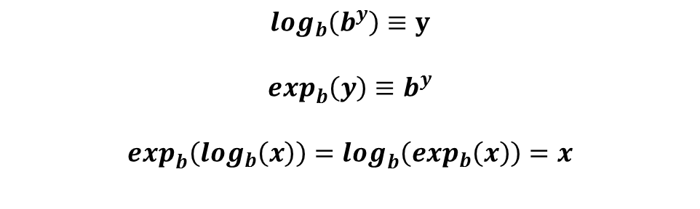
Logarithms and exponentials are reciprocal functions
$$\log_{b}\left(b^{y}\right)≡y$$
$$\exp_{b}^{}\left(y\right)≡b^{y}$$
$$\exp_{b}^{}\left(\log_{b}\left(x\right)\right)=\log_{b}^{}\left(\exp_{b}\left(x\right)\right)=x$$
INSERT
VIDEO
HERE

Slide 5
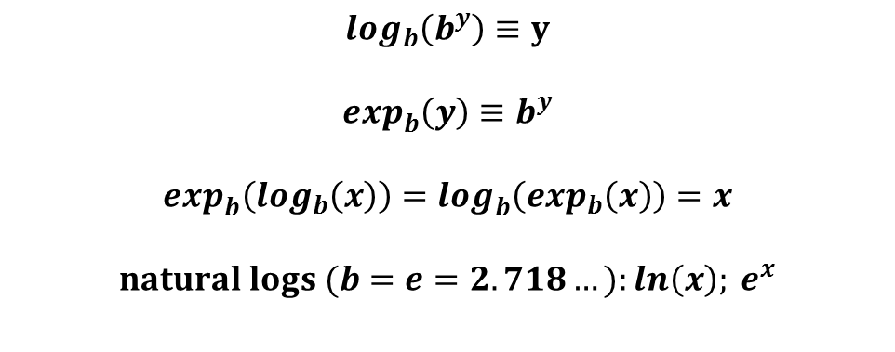
Logarithms and exponentials are reciprocal functions
$$\log_{b}\left(b^{y}\right)≡y$$
$$\exp_{b}^{}\left(y\right)≡b^{y}$$
$$\exp_{b}^{}\left(\log_{b}\left(x\right)\right)=\log_{b}^{}\left(\exp_{b}\left(x\right)\right)=x$$
$$natural logs (b=e=2.718…):ln\left(x\right); e^{x}$$
INSERT
VIDEO
HERE

Slide 6
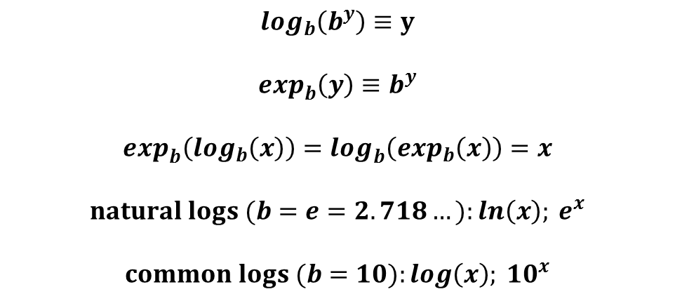
Logarithms and exponentials are reciprocal functions
$$\log_{b}\left(b^{y}\right)≡y$$
$$\exp_{b}^{}\left(y\right)≡b^{y}$$
$$\exp_{b}^{}\left(\log_{b}\left(x\right)\right)=\log_{b}^{}\left(\exp_{b}\left(x\right)\right)=x$$
$$natural logs (b=e=2.718…):ln\left(x\right); e^{x}$$
$$common logs (b=10):log\left(x\right); {10}^{x}$$
INSERT
VIDEO
HERE

Slide 7
Logarithms transform multiplication into addition
INSERT
VIDEO
HERE

Slide 8

Logarithms transform multiplication into addition
$$b>1$$
INSERT
VIDEO
HERE

Slide 9

Logarithms transform multiplication into addition
$$b>1$$
$$\log{(1)}=0$$
INSERT
VIDEO
HERE

Slide 10
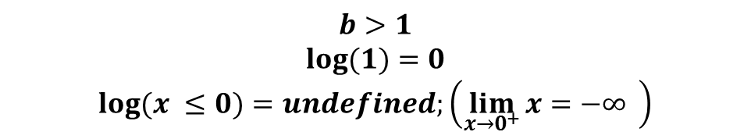
Logarithms transform multiplication into addition
$$b>1$$
$$\log{(1)}=0$$
$$\log{(x ≤0)}=undefined;\left(\lim_{x→0^{+}}{x=−∞} \right)$$
INSERT
VIDEO
HERE

Slide 11
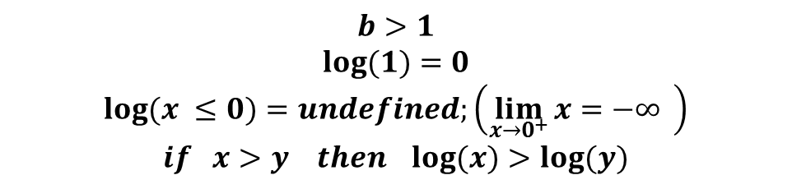
Logarithms transform multiplication into addition
$$b>1$$
$$\log{(1)}=0$$
$$\log{(x ≤0)}=undefined;\left(\lim_{x→0^{+}}{x=−∞} \right)$$
$$if x>y then\log{(x)}>\log{(y)}$$
INSERT
VIDEO
HERE

Slide 12
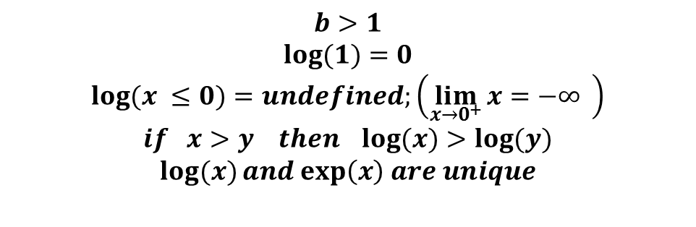
Logarithms transform multiplication into addition
$$b>1$$
$$\log{(1)}=0$$
$$\log{(x ≤0)}=undefined;\left(\lim_{x→0^{+}}{x=−∞} \right)$$
$$if x>y then\log{(x)}>\log{(y)}$$
$$\log{(x)}and exp\left(x\right) are unique$$
INSERT
VIDEO
HERE

Slide 13
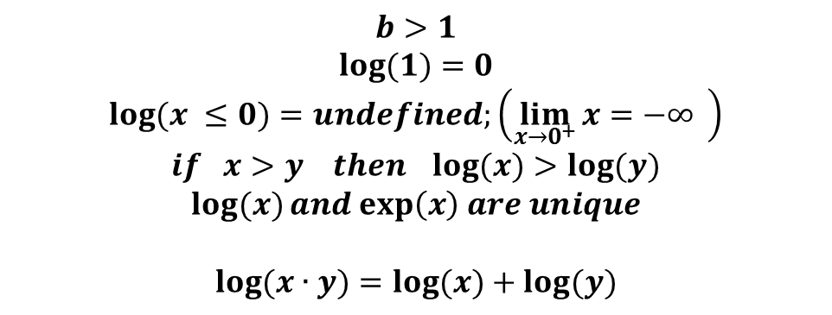
Logarithms transform multiplication into addition
$$b>1$$
$$\log{(1)}=0$$
$$\log{(x ≤0)}=undefined;\left(\lim_{x→0^{+}}{x=−∞} \right)$$
$$if x>y then\log{(x)}>\log{(y)}$$
$$\log{(x)}and exp\left(x\right) are unique$$
$$\log{(x∙y)}=\log{(x)}+\log{(y)}$$
INSERT
VIDEO
HERE

Slide 14
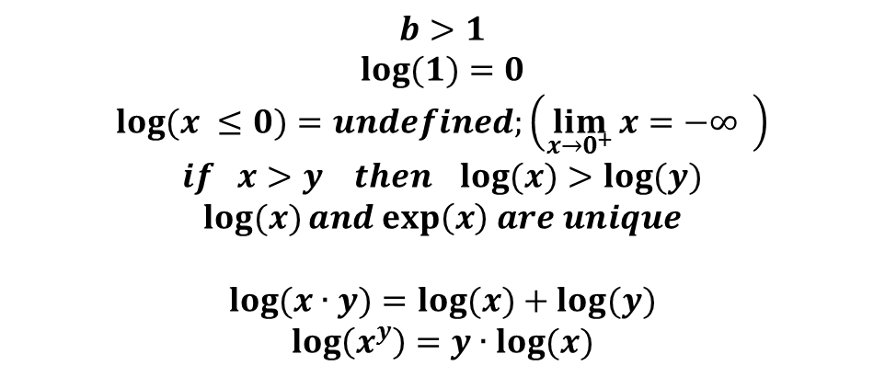
Logarithms transform multiplication into addition
$$b>1$$
$$\log{(1)}=0$$
$$\log{(x ≤0)}=undefined;\left(\lim_{x→0^{+}}{x=−∞} \right)$$
$$if x>y then\log{(x)}>\log{(y)}$$
$$\log{(x)}and exp\left(x\right) are unique$$
$$\log{(x∙y)}=\log{(x)}+\log{(y)}$$
$$\log\left(x^{y}\right)=y∙\log{(x)}$$
INSERT
VIDEO
HERE

Slide 15
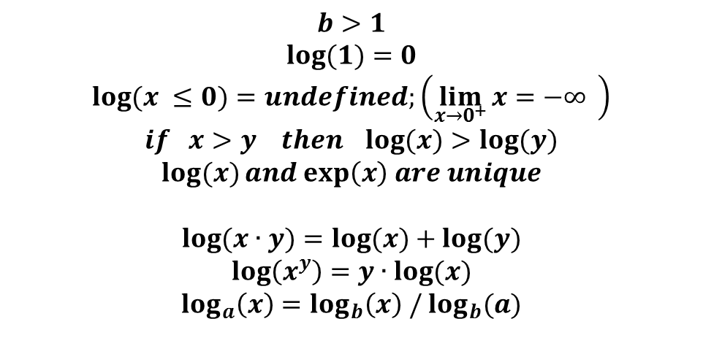
Logarithms transform multiplication into addition
$$b>1$$
$$\log{(1)}=0$$
$$\log{(x ≤0)}=undefined;\left(\lim_{x→0^{+}}{x=−∞} \right)$$
$$if x>y then\log{(x)}>\log{(y)}$$
$$\log{(x)}and exp\left(x\right) are unique$$
$$\log{(x∙y)}=\log{(x)}+\log{(y)}$$
$$\log\left(x^{y}\right)=y∙\log{(x)}$$
$$\log_{a}\left(x\right)=\log_{b}\left(x\right) /\log_{b}(a)$$
INSERT
VIDEO
HERE

Slide 16
Not all positive integers have a discrete logarithm
INSERT
VIDEO
HERE

Slide 17
Not all positive integers have a discrete logarithm
$$\log_{10}\left(100\right)=2$$
INSERT
VIDEO
HERE

Slide 18

Not all positive integers have a discrete logarithm
$$\log_{10}\left(100\right)=2$$
$$\log_{10}\left(1000\right)=3$$
INSERT
VIDEO
HERE

Slide 19

Not all positive integers have a discrete logarithm
$$\log_{10}\left(100\right)=2$$
$$\log_{10}\left(1000\right)=3$$
$$\log_{10}\left(512\right) doesn^{′}t exist$$
INSERT
VIDEO
HERE

Slide 20
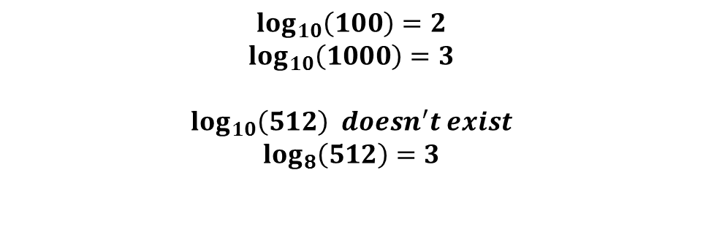
Not all positive integers have a discrete logarithm
$$\log_{10}\left(100\right)=2$$
$$\log_{10}\left(1000\right)=3$$
$$\log_{10}\left(512\right) doesn^{′}t exist$$
$$\log_{8}\left(512\right)=3$$
INSERT
VIDEO
HERE

Slide 21
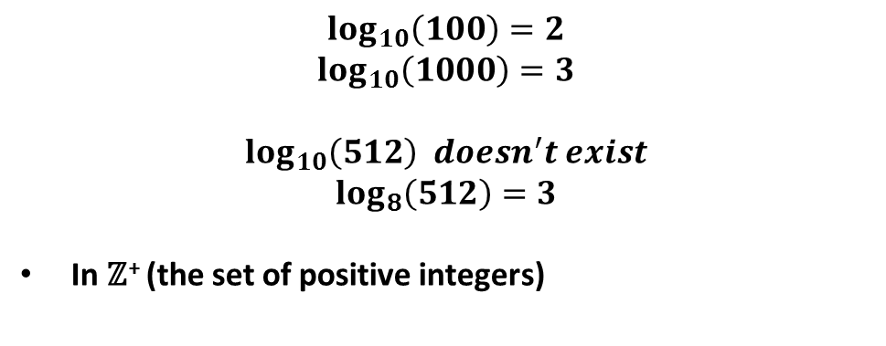
Not all positive integers have a discrete logarithm
$$\log_{10}\left(100\right)=2$$
$$\log_{10}\left(1000\right)=3$$
$$\log_{10}\left(512\right) doesn^{′}t exist$$
$$\log_{8}\left(512\right)=3$$
In ℤ⁺ (the set of positive integers)
INSERT
VIDEO
HERE

Slide 22
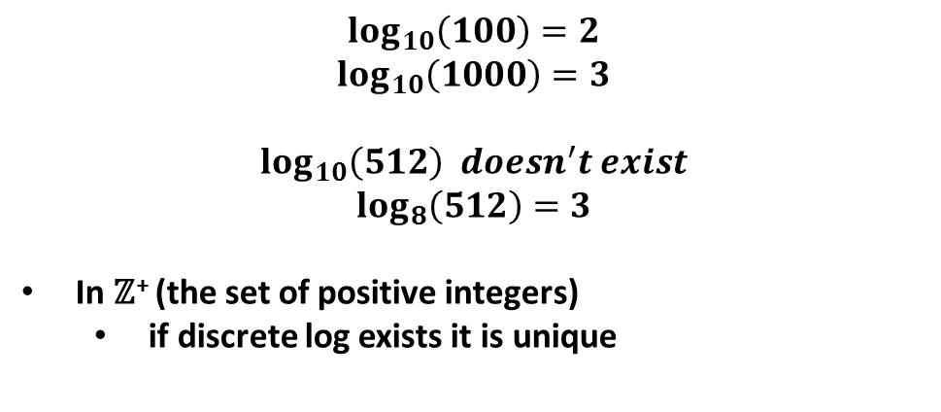
Not all positive integers have a discrete logarithm
$$\log_{10}\left(100\right)=2$$
$$\log_{10}\left(1000\right)=3$$
$$\log_{10}\left(512\right) doesn^{′}t exist$$
$$\log_{8}\left(512\right)=3$$
In ℤ⁺ (the set of positive integers)
if discrete log exists it is unique
INSERT
VIDEO
HERE

Slide 23
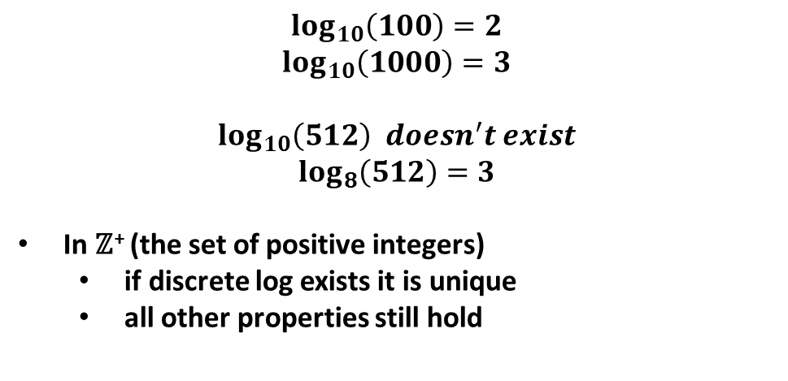
Not all positive integers have a discrete logarithm
$$\log_{10}\left(100\right)=2$$
$$\log_{10}\left(1000\right)=3$$
$$\log_{10}\left(512\right) doesn^{′}t exist$$
$$\log_{8}\left(512\right)=3$$
In ℤ⁺ (the set of positive integers)
if discrete log exists it is unique
all other properties still hold
INSERT
VIDEO
HERE

Slide 24
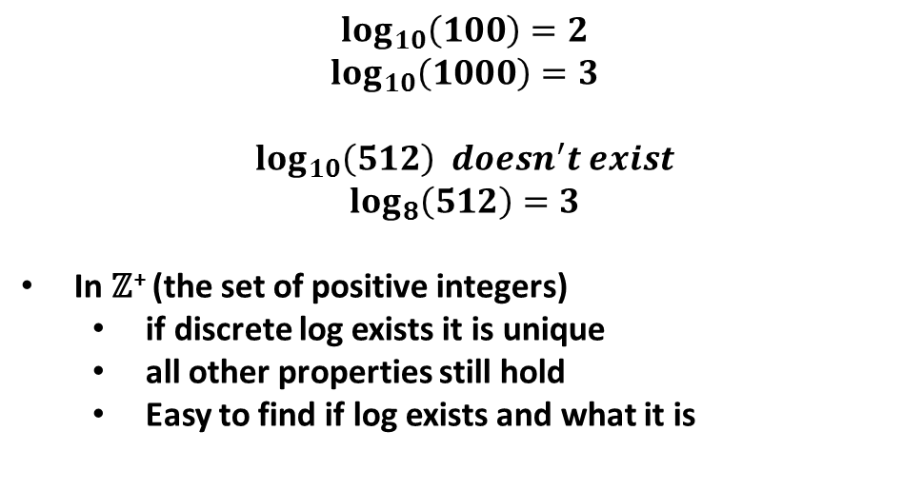
Not all positive integers have a discrete logarithm
$$\log_{10}\left(100\right)=2$$
$$\log_{10}\left(1000\right)=3$$
$$\log_{10}\left(512\right) doesn^{′}t exist$$
$$\log_{8}\left(512\right)=3$$
In ℤ⁺ (the set of positive integers)
if discrete log exists it is unique
all other properties still hold
Easy to find if log exists and what it is
INSERT
VIDEO
HERE

Slide 25
A exponentiation table can be used to find discrete logs
INSERT
VIDEO
HERE

Slide 26
A exponentiation table can be used to find discrete logs
base
0 1 2 3 4 5 6 7 8 9 10 11 12
0 | - 1 1 1 1 1 1 1 1 1 1 1 1
1 | 0 1 2 3 4 5 6 7 8 9 10 11 12
e 2 | 0 1 4 9 3 12 10 10 12 3 9 4 1
x 3 | 0 1 8 1 12 8 8 5 5 1 12 5 12
p 4 | 0 1 3 3 9 1 9 9 1 9 3 3 1
o 5 | 0 1 6 9 10 5 2 11 8 3 4 7 12
n 6 | 0 1 12 1 1 12 12 12 12 1 1 12 1
e 7 | 0 1 11 3 4 8 7 6 5 9 10 2 12
n 8 | 0 1 9 9 3 1 3 3 1 3 9 9 1
t 9 | 0 1 5 1 12 5 5 8 8 1 12 8 12
10 | 0 1 10 3 9 12 4 4 12 9 3 10 1
11 | 0 1 7 9 10 8 11 2 5 3 4 6 12
12 | 0 1 1 1 1 1 1 1 1 1 1 1 1
INSERT
VIDEO
HERE

Slide 27
A exponentiation table can be used to find discrete logs log₇()
base
0 1 2 3 4 5 6 7 8 9 10 11 12
0 | - 1 1 1 1 1 1 1 1 1 1 1 1
1 | 0 1 2 3 4 5 6 7 8 9 10 11 12
e 2 | 0 1 4 9 3 12 10 10 12 3 9 4 1
x 3 | 0 1 8 1 12 8 8 5 5 1 12 5 12
p 4 | 0 1 3 3 9 1 9 9 1 9 3 3 1
o 5 | 0 1 6 9 10 5 2 11 8 3 4 7 12
n 6 | 0 1 12 1 1 12 12 12 12 1 1 12 1
e 7 | 0 1 11 3 4 8 7 6 5 9 10 2 12
n 8 | 0 1 9 9 3 1 3 3 1 3 9 9 1
t 9 | 0 1 5 1 12 5 5 8 8 1 12 8 12
10 | 0 1 10 3 9 12 4 4 12 9 3 10 1
11 | 0 1 7 9 10 8 11 2 5 3 4 6 12
12 | 0 1 1 1 1 1 1 1 1 1 1 1 1
INSERT
VIDEO
HERE

Slide 28
A exponentiation table can be used to find discrete logs log₇(4)
base
0 1 2 3 4 5 6 7 8 9 10 11 12
0 | - 1 1 1 1 1 1 1 1 1 1 1 1
1 | 0 1 2 3 4 5 6 7 8 9 10 11 12
e 2 | 0 1 4 9 3 12 10 10 12 3 9 4 1
x 3 | 0 1 8 1 12 8 8 5 5 1 12 5 12
p 4 | 0 1 3 3 9 1 9 9 1 9 3 3 1
o 5 | 0 1 6 9 10 5 2 11 8 3 4 7 12
n 6 | 0 1 12 1 1 12 12 12 12 1 1 12 1
e 7 | 0 1 11 3 4 8 7 6 5 9 10 2 12
n 8 | 0 1 9 9 3 1 3 3 1 3 9 9 1
t 9 | 0 1 5 1 12 5 5 8 8 1 12 8 12
10 | 0 1 10 3 9 12 4 4 12 9 3 10 1
11 | 0 1 7 9 10 8 11 2 5 3 4 6 12
12 | 0 1 1 1 1 1 1 1 1 1 1 1 1
INSERT
VIDEO
HERE

Slide 29
A exponentiation table can be used to find discrete logs log₇(4) ≡ 10 (mod 13)
base
0 1 2 3 4 5 6 7 8 9 10 11 12
0 | - 1 1 1 1 1 1 1 1 1 1 1 1
1 | 0 1 2 3 4 5 6 7 8 9 10 11 12
e 2 | 0 1 4 9 3 12 10 10 12 3 9 4 1
x 3 | 0 1 8 1 12 8 8 5 5 1 12 5 12
p 4 | 0 1 3 3 9 1 9 9 1 9 3 3 1
o 5 | 0 1 6 9 10 5 2 11 8 3 4 7 12
n 6 | 0 1 12 1 1 12 12 12 12 1 1 12 1
e 7 | 0 1 11 3 4 8 7 6 5 9 10 2 12
n 8 | 0 1 9 9 3 1 3 3 1 3 9 9 1
t 9 | 0 1 5 1 12 5 5 8 8 1 12 8 12
10 | 0 1 10 3 9 12 4 4 12 9 3 10 1
11 | 0 1 7 9 10 8 11 2 5 3 4 6 12
12 | 0 1 1 1 1 1 1 1 1 1 1 1 1
INSERT
VIDEO
HERE

Slide 30
Discrete logs are not monotonic log₇(4) ≡ 10 (mod 13)
base
0 1 2 3 4 5 6 7 8 9 10 11 12
0 | - 1 1 1 1 1 1 1 1 1 1 1 1
1 | 0 1 2 3 4 5 6 7 8 9 10 11 12
e 2 | 0 1 4 9 3 12 10 10 12 3 9 4 1
x 3 | 0 1 8 1 12 8 8 5 5 1 12 5 12
p 4 | 0 1 3 3 9 1 9 9 1 9 3 3 1
o 5 | 0 1 6 9 10 5 2 11 8 3 4 7 12
n 6 | 0 1 12 1 1 12 12 12 12 1 1 12 1
e 7 | 0 1 11 3 4 8 7 6 5 9 10 2 12
n 8 | 0 1 9 9 3 1 3 3 1 3 9 9 1
t 9 | 0 1 5 1 12 5 5 8 8 1 12 8 12
10 | 0 1 10 3 9 12 4 4 12 9 3 10 1
11 | 0 1 7 9 10 8 11 2 5 3 4 6 12
12 | 0 1 1 1 1 1 1 1 1 1 1 1 1
INSERT
VIDEO
HERE

Slide 31
Discrete logs are not monotonic log₇(4) ≡ 10 (mod 13) > log₇(5) ≡ 3 (mod 13)
base
0 1 2 3 4 5 6 7 8 9 10 11 12
0 | - 1 1 1 1 1 1 1 1 1 1 1 1
1 | 0 1 2 3 4 5 6 7 8 9 10 11 12
e 2 | 0 1 4 9 3 12 10 10 12 3 9 4 1
x 3 | 0 1 8 1 12 8 8 5 5 1 12 5 12
p 4 | 0 1 3 3 9 1 9 9 1 9 3 3 1
o 5 | 0 1 6 9 10 5 2 11 8 3 4 7 12
n 6 | 0 1 12 1 1 12 12 12 12 1 1 12 1
e 7 | 0 1 11 3 4 8 7 6 5 9 10 2 12
n 8 | 0 1 9 9 3 1 3 3 1 3 9 9 1
t 9 | 0 1 5 1 12 5 5 8 8 1 12 8 12
10 | 0 1 10 3 9 12 4 4 12 9 3 10 1
11 | 0 1 7 9 10 8 11 2 5 3 4 6 12
12 | 0 1 1 1 1 1 1 1 1 1 1 1 1
INSERT
VIDEO
HERE

Slide 32
Discrete logs are not unique
base
0 1 2 3 4 5 6 7 8 9 10 11 12
0 | - 1 1 1 1 1 1 1 1 1 1 1 1
1 | 0 1 2 3 4 5 6 7 8 9 10 11 12
e 2 | 0 1 4 9 3 12 10 10 12 3 9 4 1
x 3 | 0 1 8 1 12 8 8 5 5 1 12 5 12
p 4 | 0 1 3 3 9 1 9 9 1 9 3 3 1
o 5 | 0 1 6 9 10 5 2 11 8 3 4 7 12
n 6 | 0 1 12 1 1 12 12 12 12 1 1 12 1
e 7 | 0 1 11 3 4 8 7 6 5 9 10 2 12
n 8 | 0 1 9 9 3 1 3 3 1 3 9 9 1
t 9 | 0 1 5 1 12 5 5 8 8 1 12 8 12
10 | 0 1 10 3 9 12 4 4 12 9 3 10 1
11 | 0 1 7 9 10 8 11 2 5 3 4 6 12
12 | 0 1 1 1 1 1 1 1 1 1 1 1 1
INSERT
VIDEO
HERE

Slide 33
Discrete logs are not unique log₈(5) ≡ 3 (mod 13)
base
0 1 2 3 4 5 6 7 8 9 10 11 12
0 | - 1 1 1 1 1 1 1 1 1 1 1 1
1 | 0 1 2 3 4 5 6 7 8 9 10 11 12
e 2 | 0 1 4 9 3 12 10 10 12 3 9 4 1
x 3 | 0 1 8 1 12 8 8 5 5 1 12 5 12
p 4 | 0 1 3 3 9 1 9 9 1 9 3 3 1
o 5 | 0 1 6 9 10 5 2 11 8 3 4 7 12
n 6 | 0 1 12 1 1 12 12 12 12 1 1 12 1
e 7 | 0 1 11 3 4 8 7 6 5 9 10 2 12
n 8 | 0 1 9 9 3 1 3 3 1 3 9 9 1
t 9 | 0 1 5 1 12 5 5 8 8 1 12 8 12
10 | 0 1 10 3 9 12 4 4 12 9 3 10 1
11 | 0 1 7 9 10 8 11 2 5 3 4 6 12
12 | 0 1 1 1 1 1 1 1 1 1 1 1 1
INSERT
VIDEO
HERE

Slide 34
Discrete logs are not unique log₈(5) ≡ {3, 5} (mod 13)
base
0 1 2 3 4 5 6 7 8 9 10 11 12
0 | - 1 1 1 1 1 1 1 1 1 1 1 1
1 | 0 1 2 3 4 5 6 7 8 9 10 11 12
e 2 | 0 1 4 9 3 12 10 10 12 3 9 4 1
x 3 | 0 1 8 1 12 8 8 5 5 1 12 5 12
p 4 | 0 1 3 3 9 1 9 9 1 9 3 3 1
o 5 | 0 1 6 9 10 5 2 11 8 3 4 7 12
n 6 | 0 1 12 1 1 12 12 12 12 1 1 12 1
e 7 | 0 1 11 3 4 8 7 6 5 9 10 2 12
n 8 | 0 1 9 9 3 1 3 3 1 3 9 9 1
t 9 | 0 1 5 1 12 5 5 8 8 1 12 8 12
10 | 0 1 10 3 9 12 4 4 12 9 3 10 1
11 | 0 1 7 9 10 8 11 2 5 3 4 6 12
12 | 0 1 1 1 1 1 1 1 1 1 1 1 1
INSERT
VIDEO
HERE

Slide 35
Discrete logs are not unique log₈(5) ≡ {3, 5, 11} (mod 13)
base
0 1 2 3 4 5 6 7 8 9 10 11 12
0 | - 1 1 1 1 1 1 1 1 1 1 1 1
1 | 0 1 2 3 4 5 6 7 8 9 10 11 12
e 2 | 0 1 4 9 3 12 10 10 12 3 9 4 1
x 3 | 0 1 8 1 12 8 8 5 5 1 12 5 12
p 4 | 0 1 3 3 9 1 9 9 1 9 3 3 1
o 5 | 0 1 6 9 10 5 2 11 8 3 4 7 12
n 6 | 0 1 12 1 1 12 12 12 12 1 1 12 1
e 7 | 0 1 11 3 4 8 7 6 5 9 10 2 12
n 8 | 0 1 9 9 3 1 3 3 1 3 9 9 1
t 9 | 0 1 5 1 12 5 5 8 8 1 12 8 12
10 | 0 1 10 3 9 12 4 4 12 9 3 10 1
11 | 0 1 7 9 10 8 11 2 5 3 4 6 12
12 | 0 1 1 1 1 1 1 1 1 1 1 1 1
INSERT
VIDEO
HERE

Slide 36
b^{k} not unique for a given value of k
base
0 1 2 3 4 5 6 7 8 9 10 11 12
0 | - 1 1 1 1 1 1 1 1 1 1 1 1
1 | 0 1 2 3 4 5 6 7 8 9 10 11 12
e 2 | 0 1 4 9 3 12 10 10 12 3 9 4 1
x 3 | 0 1 8 1 12 8 8 5 5 1 12 5 12
p 4 | 0 1 3 3 9 1 9 9 1 9 3 3 1
o 5 | 0 1 6 9 10 5 2 11 8 3 4 7 12
n 6 | 0 1 12 1 1 12 12 12 12 1 1 12 1
e 7 | 0 1 11 3 4 8 7 6 5 9 10 2 12
n 8 | 0 1 9 9 3 1 3 3 1 3 9 9 1
t 9 | 0 1 5 1 12 5 5 8 8 1 12 8 12
10 | 0 1 10 3 9 12 4 4 12 9 3 10 1
11 | 0 1 7 9 10 8 11 2 5 3 4 6 12
12 | 0 1 1 1 1 1 1 1 1 1 1 1 1
INSERT
VIDEO
HERE

Slide 37
b^{k} not unique for a given value of k
base
0 1 2 3 4 5 6 7 8 9 10 11 12
0 | - 1 1 1 1 1 1 1 1 1 1 1 1
1 | 0 1 2 3 4 5 6 7 8 9 10 11 12
e 2 | 0 1 4 9 3 12 10 10 12 3 9 4 1
x 3 | 0 1 8 1 12 8 8 5 5 1 12 5 12
p 4 | 0 1 3 3 9 1 9 9 1 9 3 3 1
o 5 | 0 1 6 9 10 5 2 11 8 3 4 7 12
n 6 | 0 1 12 1 1 12 12 12 12 1 1 12 1
e 7 | 0 1 11 3 4 8 7 6 5 9 10 2 12
n 8 | 0 1 9 9 3 1 3 3 1 3 9 9 1
t 9 | 0 1 5 1 12 5 5 8 8 1 12 8 12
10 | 0 1 10 3 9 12 4 4 12 9 3 10 1
11 | 0 1 7 9 10 8 11 2 5 3 4 6 12
12 | 0 1 1 1 1 1 1 1 1 1 1 1 1
INSERT
VIDEO
HERE

Slide 38
b^{k} not unique for a given value of k
base
0 1 2 3 4 5 6 7 8 9 10 11 12
0 | - 1 1 1 1 1 1 1 1 1 1 1 1
1 | 0 1 2 3 4 5 6 7 8 9 10 11 12
e 2 | 0 1 4 9 3 12 10 10 12 3 9 4 1
x 3 | 0 1 8 1 12 8 8 5 5 1 12 5 12
p 4 | 0 1 3 3 9 1 9 9 1 9 3 3 1
o 5 | 0 1 6 9 10 5 2 11 8 3 4 7 12
n 6 | 0 1 12 1 1 12 12 12 12 1 1 12 1
e 7 | 0 1 11 3 4 8 7 6 5 9 10 2 12
n 8 | 0 1 9 9 3 1 3 3 1 3 9 9 1
t 9 | 0 1 5 1 12 5 5 8 8 1 12 8 12
10 | 0 1 10 3 9 12 4 4 12 9 3 10 1
11 | 0 1 7 9 10 8 11 2 5 3 4 6 12
12 | 0 1 1 1 1 1 1 1 1 1 1 1 1
INSERT
VIDEO
HERE

Slide 39
Primitive roots generate all relatively prime values if g is primitive root & gcd(a,N) = 1, a ≡ g^{k} (mod N) for some k
base
0 1 2 3 4 5 6 7 8 9 10 11 12
0 | - 1 1 1 1 1 1 1 1 1 1 1 1
1 | 0 1 2 3 4 5 6 7 8 9 10 11 12
e 2 | 0 1 4 9 3 12 10 10 12 3 9 4 1
x 3 | 0 1 8 1 12 8 8 5 5 1 12 5 12
p 4 | 0 1 3 3 9 1 9 9 1 9 3 3 1
o 5 | 0 1 6 9 10 5 2 11 8 3 4 7 12
n 6 | 0 1 12 1 1 12 12 12 12 1 1 12 1
e 7 | 0 1 11 3 4 8 7 6 5 9 10 2 12
n 8 | 0 1 9 9 3 1 3 3 1 3 9 9 1
t 9 | 0 1 5 1 12 5 5 8 8 1 12 8 12
10 | 0 1 10 3 9 12 4 4 12 9 3 10 1
11 | 0 1 7 9 10 8 11 2 5 3 4 6 12
12 | 0 1 1 1 1 1 1 1 1 1 1 1 1
INSERT
VIDEO
HERE

Slide 40
Primitive roots generate all relatively prime values if g is primitive root & gcd(a,N) = 1, a ≡ g^{k} (mod N) for some k
base
0 1 2 3 4 5 6 7 8 9 10 11 12
0 | - 1 1 1 1 1 1 1 1 1 1 1 1
1 | 0 1 2 3 4 5 6 7 8 9 10 11 12
e 2 | 0 1 4 9 3 12 10 10 12 3 9 4 1
x 3 | 0 1 8 1 12 8 8 5 5 1 12 5 12
p 4 | 0 1 3 3 9 1 9 9 1 9 3 3 1
o 5 | 0 1 6 9 10 5 2 11 8 3 4 7 12
n 6 | 0 1 12 1 1 12 12 12 12 1 1 12 1
e 7 | 0 1 11 3 4 8 7 6 5 9 10 2 12
n 8 | 0 1 9 9 3 1 3 3 1 3 9 9 1
t 9 | 0 1 5 1 12 5 5 8 8 1 12 8 12
10 | 0 1 10 3 9 12 4 4 12 9 3 10 1
11 | 0 1 7 9 10 8 11 2 5 3 4 6 12
12 | 0 1 1 1 1 1 1 1 1 1 1 1 1
INSERT
VIDEO
HERE

Slide 41
Finding discrete logarithms in a modular world is “hard“
INSERT
VIDEO
HERE

Slide 42
Finding discrete logarithms in a modular world is “hard“
log₇(8) ≡ 9 (mod 13)
INSERT
VIDEO
HERE

Slide 43
Finding discrete logarithms in a modular world is “hard“
log₇(8) ≡ 9 (mod 13)
log₇(8) ≢ log₇(4) + log₇(2) ≡ 10 + 11 ≡ 8 (mod 13)
INSERT
VIDEO
HERE

Slide 44
Finding discrete logarithms in a modular world is “hard“
log₇(8) ≡ 9 (mod 13)
log₇(8) ≢ log₇(4) + log₇(2) ≡ 10 + 11 ≡ 8 (mod 13)
They do not obey normal rules even when they exist
INSERT
VIDEO
HERE

Slide 45
Finding discrete logarithms in a modular world is “hard“
log₇(8) ≡ 9 (mod 13)
log₇(8) ≢ log₇(4) + log₇(2) ≡ 10 + 11 ≡ 8 (mod 13)
They do not obey normal rules even when they exist
Logarithms live in a mod-totient world
INSERT
VIDEO
HERE

Slide 46
Finding discrete logarithms in a modular world is “hard“
log₇(8) ≡ 9 (mod 13)
log₇(8) ≢ log₇(4) + log₇(2) ≡ 10 + 11 ≡ 8 (mod 13)
They do not obey normal rules even when they exist
Logarithms live in a mod-totient world
b^{x} ≡ b^{y} (mod N) if x ≡ y (mod ϕ(N))
INSERT
VIDEO
HERE

Slide 47
Finding discrete logarithms in a modular world is “hard“
log₇(8) ≡ 9 (mod 13)
log₇(8) ≢ log₇(4) + log₇(2) ≡ 10 + 11 ≡ 8 (mod 13)
They do not obey normal rules even when they exist
Logarithms live in a mod-totient world
b^{x} ≡ b^{y} (mod N) if x ≡ y (mod ϕ(N))
7⁹ ≡ 7¹⁰∙7¹¹ ≡ 7^{(10 + 11) mod 12} ≡ 7⁹ (mod 13)
INSERT
VIDEO
HERE

Slide 48
Finding discrete logarithms in a modular world is “hard“
log₇(8) ≡ 9 (mod 13)
log₇(8) ≢ log₇(4) + log₇(2) ≡ 10 + 11 ≡ 8 (mod 13)
They do not obey normal rules even when they exist
Logarithms live in a mod-totient world
b^{x} ≡ b^{y} (mod N) if x ≡ y (mod ϕ(N))
7⁹ ≡ 7¹⁰∙7¹¹ ≡ 7^{(10 + 11) mod 12} ≡ 7⁹ (mod 13)
No reliable pattern exists to help find discrete logs
INSERT
VIDEO
HERE

Slide 49
Finding discrete logarithms in a modular world is “hard“
log₇(8) ≡ 9 (mod 13)
log₇(8) ≢ log₇(4) + log₇(2) ≡ 10 + 11 ≡ 8 (mod 13)
They do not obey normal rules even when they exist
Logarithms live in a mod-totient world
b^{x} ≡ b^{y} (mod N) if x ≡ y (mod ϕ(N))
7⁹ ≡ 7¹⁰∙7¹¹ ≡ 7^{(10 + 11) mod 12} ≡ 7⁹ (mod 13)
No reliable pattern exists to help find discrete logs
Discrete Log Problem
INSERT
VIDEO
HERE

Slide 50
Finding discrete logarithms in a modular world is “hard“
log₇(8) ≡ 9 (mod 13)
log₇(8) ≢ log₇(4) + log₇(2) ≡ 10 + 11 ≡ 8 (mod 13)
They do not obey normal rules even when they exist
Logarithms live in a mod-totient world
b^{x} ≡ b^{y} (mod N) if x ≡ y (mod ϕ(N))
7⁹ ≡ 7¹⁰∙7¹¹ ≡ 7^{(10 + 11) mod 12} ≡ 7⁹ (mod 13)
No reliable pattern exists to help find discrete logs
Discrete Log Problem
No known efficient way to find them
INSERT
VIDEO
HERE

Slide 51
Finding discrete logarithms in a modular world is “hard“
log₇(8) ≡ 9 (mod 13)
log₇(8) ≢ log₇(4) + log₇(2) ≡ 10 + 11 ≡ 8 (mod 13)
They do not obey normal rules even when they exist
Logarithms live in a mod-totient world
b^{x} ≡ b^{y} (mod N) if x ≡ y (mod ϕ(N))
7⁹ ≡ 7¹⁰∙7¹¹ ≡ 7^{(10 + 11) mod 12} ≡ 7⁹ (mod 13)
No reliable pattern exists to help find discrete logs
Discrete Log Problem
No known efficient way to find them
“efficient” = poly-time in number of bits of modulus.
INSERT
VIDEO
HERE

Slide 52
Some modern crypto relies on no efficient solution to Discrete Log Problem even though such a solution could be found tomorrow
INSERT
VIDEO
HERE

Slide 53
Some modern crypto relies on no efficient solution to Discrete Log Problem even though such a solution could be found tomorrow
Whether an efficient solution exists is an unknown
INSERT
VIDEO
HERE

Slide 54
Some modern crypto relies on no efficient solution to Discrete Log Problem even though such a solution could be found tomorrow
Whether an efficient solution exists is an unknown
Critical cryptosystems rely on no efficient solution
INSERT
VIDEO
HERE

Slide 55
Some modern crypto relies on no efficient solution to Discrete Log Problem even though such a solution could be found tomorrow
Whether an efficient solution exists is an unknown
Critical cryptosystems rely on no efficient solution
An efficient solution would break these systems
INSERT
VIDEO
HERE

Slide 56
Some modern crypto relies on no efficient solution to Discrete Log Problem even though such a solution could be found tomorrow
Whether an efficient solution exists is an unknown
Critical cryptosystems rely on no efficient solution
An efficient solution would break these systems
It is suspected that no efficient solution exists
INSERT
VIDEO
HERE

Slide 57
Some modern crypto relies on no efficient solution to Discrete Log Problem even though such a solution could be found tomorrow
Whether an efficient solution exists is an unknown
Critical cryptosystems rely on no efficient solution
An efficient solution would break these systems
It is suspected that no efficient solution exists
Suspected unsolvable problems are occasionally solved
INSERT
VIDEO
HERE

Slide 58
Some modern crypto relies on no efficient solution to Discrete Log Problem even though such a solution could be found tomorrow
Whether an efficient solution exists is an unknown
Critical cryptosystems rely on no efficient solution
An efficient solution would break these systems
It is suspected that no efficient solution exists
Suspected unsolvable problems are occasionally solved
Why are we willing to rely on this?
INSERT
VIDEO
HERE

Slide 59
Some modern crypto relies on no efficient solution to Discrete Log Problem even though such a solution could be found tomorrow
Whether an efficient solution exists is an unknown
Critical cryptosystems rely on no efficient solution
An efficient solution would break these systems
It is suspected that no efficient solution exists
Suspected unsolvable problems are occasionally solved
Why are we willing to rely on this?
Compromise between the desirable and the possible
INSERT
VIDEO
HERE

Slide 60
Some modern crypto relies on no efficient solution to Discrete Log Problem even though such a solution could be found tomorrow
Whether an efficient solution exists is an unknown
Critical cryptosystems rely on no efficient solution
An efficient solution would break these systems
It is suspected that no efficient solution exists
Suspected unsolvable problems are occasionally solved
Why are we willing to rely on this?
Compromise between the desirable and the possible
Looking for practical provably hard problems
INSERT
VIDEO
HERE

Slide 61
Some modern crypto relies on no efficient solution to Discrete Log Problem even though such a solution could be found tomorrow
Whether an efficient solution exists is an unknown
Critical cryptosystems rely on no efficient solution
An efficient solution would break these systems
It is suspected that no efficient solution exists
Suspected unsolvable problems are occasionally solved
Why are we willing to rely on this?
Compromise between the desirable and the possible
Looking for practical provably hard problems
Improving hardware to make known problems useful
INSERT
VIDEO
HERE

